Slide 1
Point-and-Click Your Way to Awesomeness with Process Builder
Tracy Warfield

Slide 2
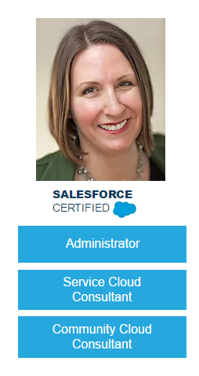
TJ Warfield
Salesforce Technical Strategist, BrightStep Partners
Head Data Geek, Data Geeks Lab

Slide 3
When to Flow
Workflow Rule
Single field updates
No hierarchical criteria
API issues with integrated apps
Process Builder
Hierarchical criteria
Multiple updates
Create records
Update child records
Process flow requires delay mid-stream
Visual Flow
Create/update Campaign Members
Lookup data from related records
Delete Records
Call existing apex
Collect info from users
Apex
When all else fails
Salesforce suggests to start with Process Builder

Slide 4
Process Builder = Flow
Email errors from Process Builder will refer to it’s Flow name and ID

Slide 5
Consolidate Workflow Rules
Acknowledgement Letter Types
Memorial – gift has a Memorial Tribute Type
Platinum – gift is $5,000 or over
Gold – gift is $1,000 - $4,999
Sustainer – is part of a recurring donation
Silver – gift is less than $1,000
But what happens if you have a gift that fits more than one?
Memorial gift of $1,500
A $50 sustainer
Badness. Badness happens

Slide 6
You can’t set firing order of WFRs
Your Options
Add exclusion criteria to all your Workflow Rule
Replace all of them with a single Process Builder

Slide 7
One Process to Code Them All
Let’s create a single Process builder to replace the five workflow rules
Memorial – gift has a Memorial Tribute Type
Platinum – gift is $5,000 or over
Gold – gift is $1,000 - $4,999
Sustainer – is part of a recurring donation
Silver – gift is less than $1,000

Slide 8
Let’s Do This Together!

Slide 9
Create Records with Process Builder
The organization offers free memberships to students. The website creates a campaign member record in the Free Grad campaign.
When a Free Grad Campaign Member record is created,
Create a $0 opportunity
With the appropriate member level and start/expiration dates.

Slide 10
Let’s See What That Looks Like!

Slide 11
When to Flow
Workflow Rule
Single field updates
No hierarchical criteria
API issues with integrated apps
Process Builder
Hierarchical criteria
Multiple updates
Create records
Update child records
Process flow requires delay mid-stream
Visual Flow
Create/update Campaign Members
Lookup data from related records
Delete Records
Call existing apex
Collect info from users
Apex
When all else fails
Salesforce suggests to start with Process Builder

Slide 12
But Why Not Process Builder?
You can’t create something that already exists
You can’t update something that doesn’t exist
If the contact has already been added to the campaign by the automation or manually entered, Process Builder will error out
This means your contact won’t save either!

Slide 13
HUB Post to Walk You Through It
https://goo.gl/rZhNlk

Slide 14
Q’s and Use Cases

